Slide 3



Fabian Imaz
Siderys
Arquitecto, eso dice ☺
MVP SharePoint Server
http://www.siderysbsn.com
http://blog.siderys.com
@fabianimaz

Slide 4

Gustavo Velez
MVP SharePoint Server
http://www.gavd.net
gustavo@gavd.net

Slide 5
SharePoint Server 2016

Slide 6

Timeline
Timeline
Beta en Q4 2015
RTM en Q2/Q3 2016

Slide 7
Requisitos
Soportado en Windows Server 2012 R2 y Windows Server Technical Preview
SQL Server 2014 y SQL Server 2016
DotNet Framework:
Windows Server 2012 R2: SharePoint 16 requiere .NET Framework 4.5.2
Windows Server Technical Preview "Threshold": SharePoint 16 requiere .NET Framework 4.6 Preview
SharePoint Server 2016 prerequisitos son similares a los requeridos para instalar a SharePoint Server 2013

Slide 8
Upgrade y Migración
Solo de 2013 a 2016
Solo Database-Attach
Site Collections compatibles en modo SharePoint 2010 tienen que ser convertidas a 2013 antes de la migración
Framework para migración hacia Office 365

Slide 9
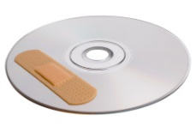
Zero Downtime Patching
Microsoft promete “zero downtime patching”
Aplicación de patches mientras las granja sigue funcionando en una forma similar a SharePoint online

Slide 10
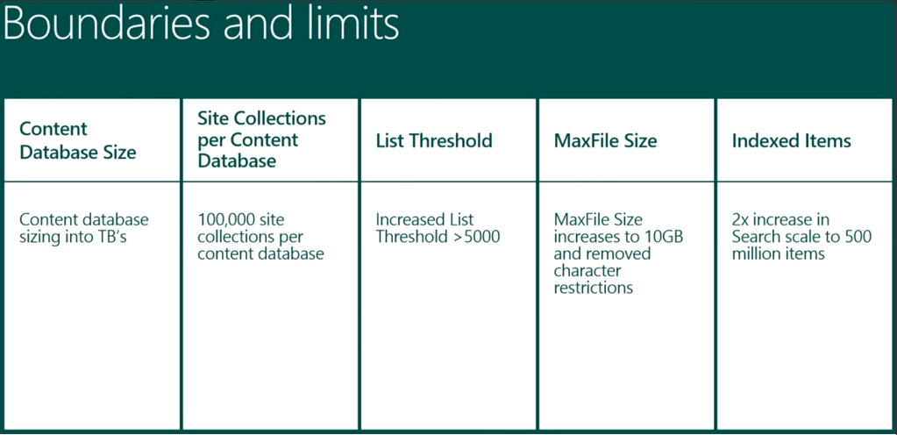
Nuevos limites

Slide 11
MiniRoles
Role Name | Description
Special Load | Reserved for services to be isolated from other services, I.e. 3rd party, PerformancePoint, etc.
Web Front End | Services end user requests, optimized for low latency.
Single Server Farm | Provisions all services on the server for a single server deployment. This role is provided for evaluation and development purposes.
Search | Reserved for Search services.
Application | Services the backend jobs or the requests triggered by backend jobs, optimized for high throughput.
Distributed Cache | Services distributed cache for the farm. Optionally, the server assigned to this role can load balance end user requests among the web front ends.

Slide 12
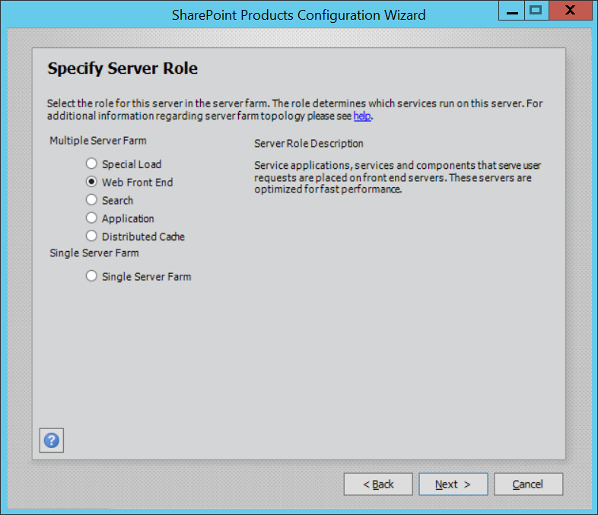
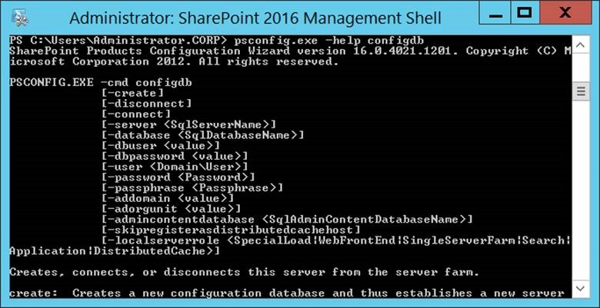
MiniRoles

Slide 13
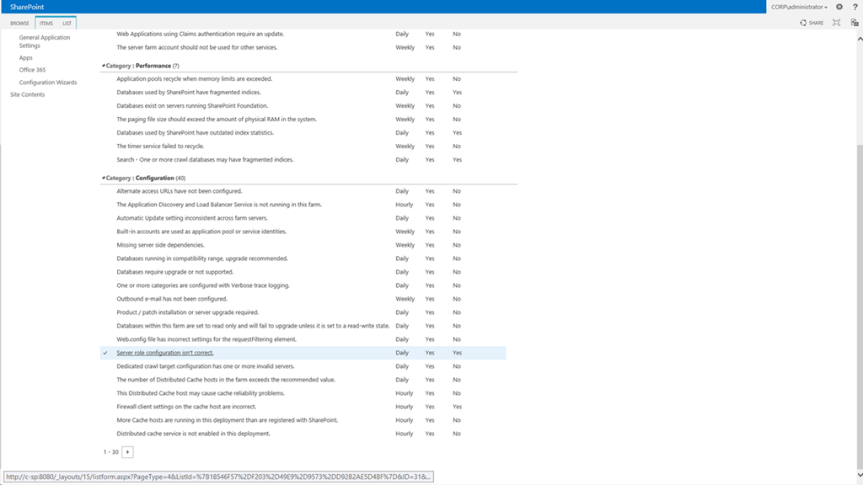
Health Rules basadas en MiniRoles

Slide 14
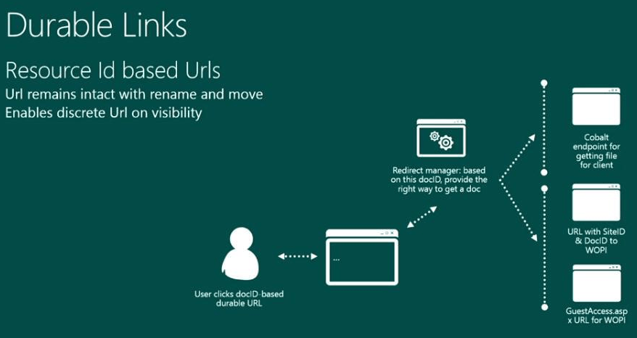
Vínculos Durables
In SharePoint 2013 se puede activar el servicio de Document ID service para generar IDs únicos, pero solo para una site collection especifica

Slide 15
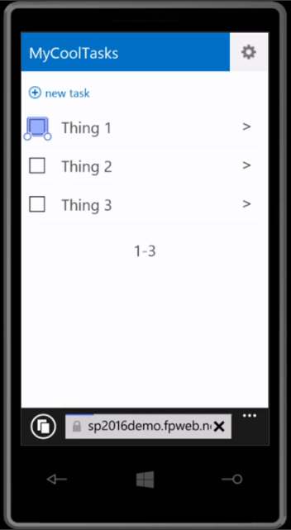
Mobile UI
Office 365 tiene una UI Mobile que se va a implementar también en SharePoint 2016

Slide 16
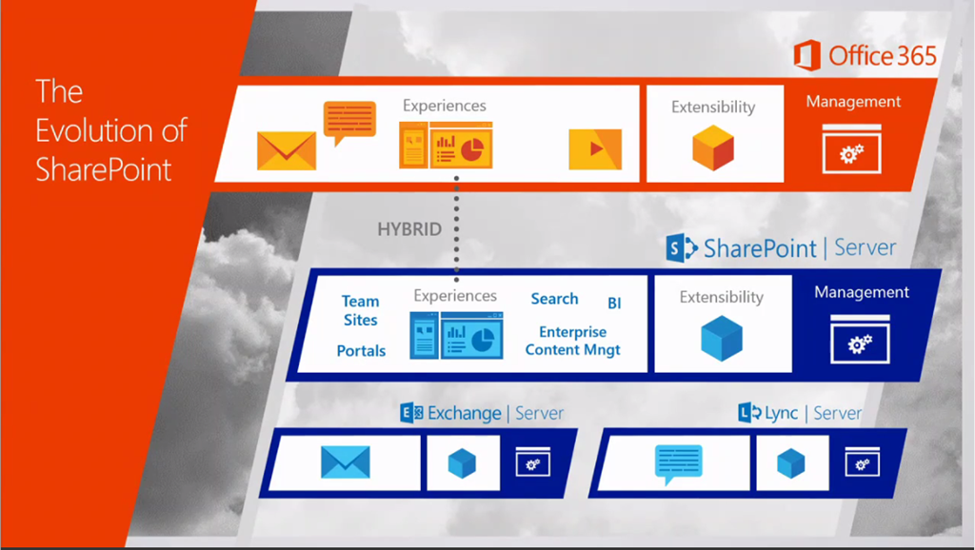
Facilitando Escenarios Híbridos

Slide 17
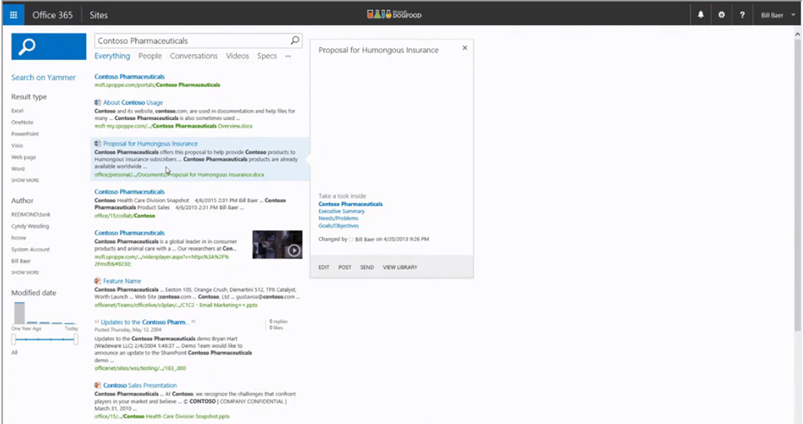
Facilitando Escenarios Híbridos
Búsqueda Hibrida

Slide 18
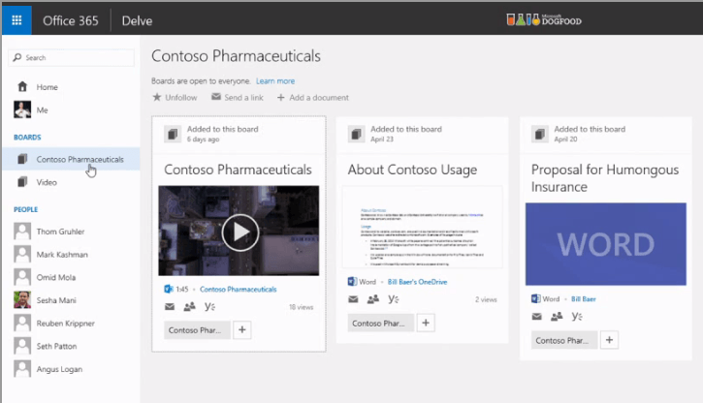
Facilitando Escenarios Híbridos
Contenido OnPremises en Delve

Slide 19

Rumores (???)
No Foundation
User Profile Service Application removida

Slide 20
Noticias difundidas por Microsoft
The next version of SharePoint server will be the most secure, stable and reliable version to date—allowing organizations to take advantage of cloud innovation on their terms.
SharePoint Server 2016 will offer customers enhanced, flexible deployment options, improved reliability and new IT agility, enabled for massive scale.
With SharePoint Server 2016, in addition to delivering rich on-premises capabilities, Microsoft will focus on robust hybrid enablement in order to bring more of the Office 365 experiences to the on-premises Customers.
The InfoPath 2013 application remains the last version to be released and will work with SharePoint Server 2016.
Microsoft will be delivering new ‘ready-to-go’ Portals that historically would have taken customers weeks, if not months, to build. NextGen Portals, by design, are intelligent, collaborative, mobile and ready to go. Office 365 Video, delivered in 2014, is the first NextGen Portal.
Expanding the concept of team sites, MS will bring together team content traditionally kept in SharePoint, along with the broader set of information across Office 365 including email, instant messaging, tasks, contacts, personal files, social feeds and more. This holistic team experience across Office 365 will offer simplified permissions for the user and holistic management, governance and extensibility models, making it a win for IT and for users.
With Power BI, MS will provide an opportunity to Create a “ready to go” solutions that users and IT can get up and running in minutes. Built on top of Office 365, Power BI provides an integrated analytical platform in the cloud that connects to your important information from where it lives via the Excel interface users know.
To help users work in new, more dynamic ways, MS Integrated the Yammer experience alongside Office documents and videos, as well as common line of business applications such as Dynamics CRM and Salesforce.com, and offer mobile access across platforms

Slide 21
Demo: Nos gustaría pero no podemos mostrarlo aún ☺

